Slide 1


Slide 2

🐜 Colony Optimization (Swarm Intelligence)
Name | ID | Level | Department
Aya Muhammed Kurtam | 20180150 | 3 | CS
Eslam Shawky Adly | 20180109 | 3 | IS
Ahmed Tarek Eid Omara | 20180047 | 3 | IS
Gehad Essam Rabea | 20180177 | 3 | IS
Sayed Moataz Muhammed Sayed | 20180276 | 3 | CS

Slide 3
Swarm Intelligence
Ant Colony optimization (aco)

Slide 4
Outline
Introduction
Overview
Swarm Intelligence (ACO)
ACO Pheromone Definition
ACO Algorithm
ACO Pseudo code
Advantages and Disadvantages of ACO
Applications
References

Slide 5
Introduction
It is a part in the field of artificial intelligence. swarm intelligence adopts the collective behavior of decentralized, self-organized systems like (group of animals) ,as they strive to survive.
Birds, bees, fish and ants all of these creatures have evolved methods of amplifying their intelligence by thinking together in systems.
This is why birds flock and bees swarm, they are smarter together than alone.

Slide 6
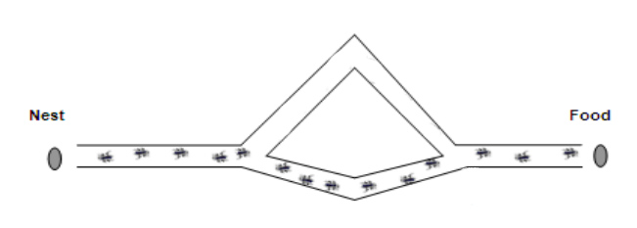
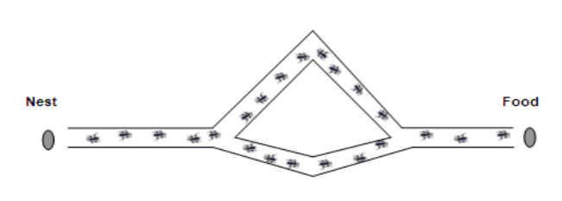
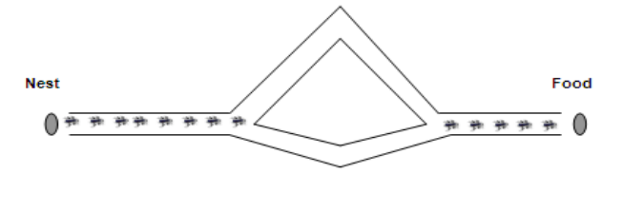
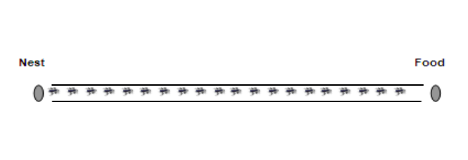
Naturally observed ant behavior

Slide 7
Overview on ACO
This algorithm is a member of the ant colony algorithms family, in swarm intelligence methods, and it constitutes some metaheuristic optimizations.
In COMPUTER SCIENCE and OPERATION RESEARCH, the ant colony optimization algorithm(ACO) is a probabilistic technique for solving computational problems which can be reduced to finding good paths through graphs.
First introduced by Marco Dorigo in 1992 . Originally applied to traveling salesman problem.

Slide 8
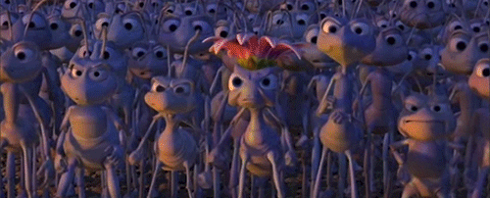
Swarm Intelligence
Main Idea ..
Actually, the main idea is to collaborate together and behave as single entity which performs better than individuals .
The principles was inspired from collective insect societies which is helping in developing computer algorithms and motion control principles for robotics

Slide 9
SI Algorithms
Particle swarm optimization (PSO)
Ant colony optimization (ACO)
Artificial Bee Colony (ABC)
Genetic Algorithms (GA)
Differential Evolution (DE)
Glowworm Swarm Optimization (GSO)

Slide 10
Benefits of SI
Derivative free optimization
Robustness
Swarm Intelligence
Benefits
Flexibility
Easy marketing and
implementation
Low total cost

Slide 11
Capabilities of Swarm Intelligence :
Scheduling
Optimization
Swarm Intelligence
Capabilities
Clustering
Routing

Slide 12
Applications of SI
Ant-based routing: The use of swarm intelligence in telecommunication networks has also been researched, in the form of ant-based routing.
Crowd simulation
Human swarming
Swarmic art
Flying robots
Kilobot

Slide 13
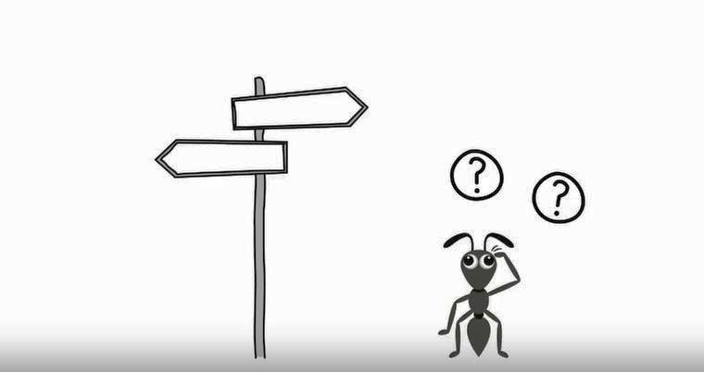
ACO Definition
What is Ant Colony Optimization ?

Slide 14

ACO Definition
History
ACO studies artificial systems that take inspiration from behavior of real ant colonies.
Natural behavior of ants have inspired scientists to mimic insect operational methods to solve real life complex optimization problems.
It constitutes some metaheuristic optimizations.
The inventors are Frans Moyson and Bernard Manderick. Initially proposed by Marco Dorigo in 1992 in his PhD thesis, The first ACO algorithm was called the Ant system and it was aimed to solve the travelling salesman problem, in which the goal is to find the shortest round trip to link a series of cities. At each stage, the ant chooses to move from one city to another according to some rules.

Slide 15
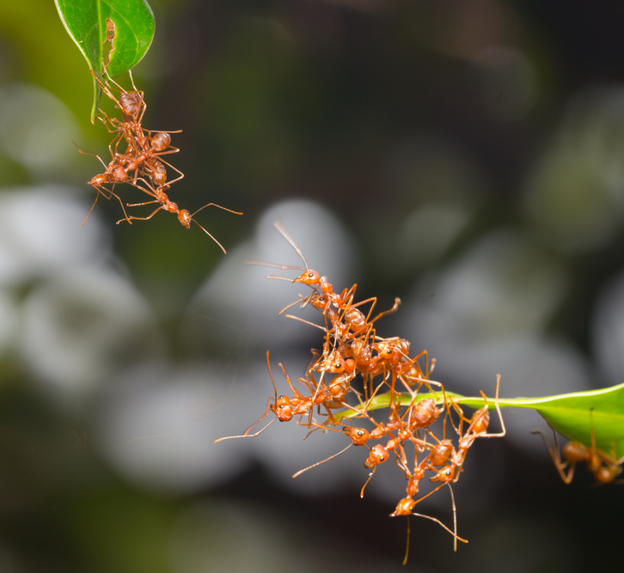
ACO Definition
Concept ..
THE WHOLE CONCEPT OF ANT COLONY OPTIMIZATION IS TO MINIMIZE THE PATH AND POWER CONSUMPTION

Slide 16
ACO Definition
What is ACO ?
Artificial Ants stand for multi-agent methods inspired by the behavior of real ants.
Combinations of Artificial Ants and local search algorithms have become a method of choice for numerous optimization tasks involving some sort of graph, e.g., vehicle routing and internet routing.
A colony is a population of simple, independent, and asynchronous agents that cooperate to ﬁnd a good solution to the problem.

Slide 17

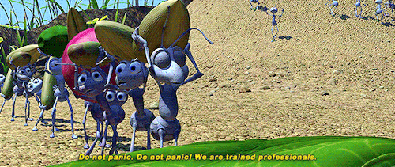
Pheromone Definition
Shortest path is discovered via pheromone trails.
Pheromone : is an organic compound Ants deposit while tracing a path.
Methodology is based on the ant’s capability of finding the shortest path from the nest to a food source.
More pheromone on path increases probability of path being followed.

Slide 18
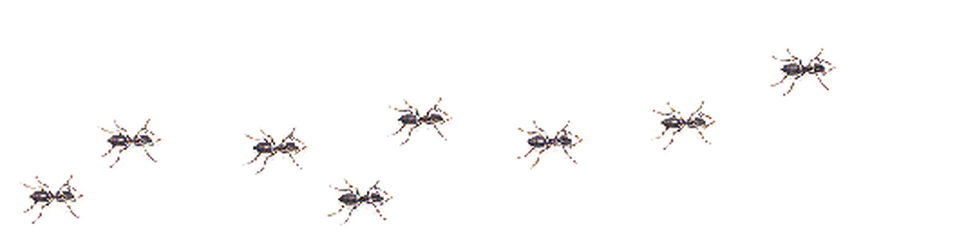
Ant Colony Optimization Algorithms
Ant Colony Optimization is a swarm intelligence technique and a metaheuristic which is inspired by the behavior of real ants in their search for food.
The ants in ACO are stochastic solution construction procedures that probabilistically and iteratively build complete solutions from smaller components.
It is this cooperation on a colony level that gives the members of the ACO algorithm family their distinctive flavor.
Notes:
Metaheuristic: An experimental heuristic method for solving a general class of computational problems by combining user procedures in the hope of obtaining a more efficient or robust procedure.

Slide 19
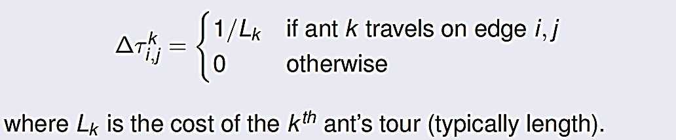
Ant Colony Optimization Algorithms
- Amount of pheromone is updated according to the equation
τi,j = (1- ρ) τ i,j + ∆τi,j
where
τi,j is the amount of pheromone on a given edge i, j
ρ is the rate of pheromone evaporation
τi,j is the amount of pheromone deposited, typically given by

Slide 20
Ant Colony Optimization Algorithms
- An ant will move from node i to node j with probability
α
β
T: Taw
η: eetaa
(τ )
p
( η )
__________
=
i,j
i,j
i,j
α
β
(τ )
( η )
i,j
i,j
where
τ
is the amount of pheromone on a given edge i, j
i,j
β and α are parameters which are used to arrange to influence of local trail values and visibility (0 ≤ α , β ≤ 1)
η is the desirability of edge i, j (typically 1 / Li,j)
i,j

Slide 21

Ant Colony Optimization Pseudo code
Algorithm in Pseudo code:
Initialize Trial
Do while (Stopping Criteria Not Satisfied) - Cycle Loop
Do Until (Each Ant Completes a Tour) - Tour Loop
Local Trial Update
End Do
Analyze Tours
Global Trial Update
End Do

Slide 22
ACO Advantages:
Distributed computation avoids premature convergence
Early solution in the early stages of the search process.
The collective interaction of a population of agents.
Retains memory of the entire colony instead of the previous generation only
Less affected by poor initial solutions
Has been applied to a wide variety of applications
Inherent parallelism
Positive Feedback accounts for rapid discovery of good solutions
Efficient for Traveling Salesman Problem and similar problems
Can be used in dynamic applications (adapts to changes such as new distances, etc.)

Slide 23
ACO Disadvantages:
Theoretical analysis is difficult
Sequences of random decisions (not independent)
Probability distribution changes by iteration
Research is experimental rather than theoretical
Time to convergence uncertain (but convergence is guaranteed!)
Slower convergence than other Heuristics
Performed poorly for TSP problems larger than 75 cities

Slide 24
ACO Applications:
Network routing problem
ACO algorithm is applied in the network routing problems to find the shortest path
A set of artificial ants (packets) are simulated from a source to the destination
The forward ants are selecting the next node randomly for the first time taking the information from the routing table
Ants who are successful in reaching the destination are updating the pheromone deposit at the edges visited by them
The next set of the ants can now learn from the pheromone deposit feedback left by the previously visited successful ants and will be guided to follow the shortest path

Slide 25
ACO Applications:
Traveling Salesman Problem
The goal is to find the shortest round trip to link a series of cities.
At each stage, the Salesman chooses to move from one city to another according to some rules:
Salesman has to start from one place .
It must visit each city exactly once .
come back to original city .

Slide 26

ACO Applications:
Data mining
Discounted cash flows in project scheduling
Grid Workflow Scheduling Problem
Image processing
Intelligent testing system
Power Electronic Circuit Design

Slide 27
References
Ant colony optimization and the vehicle routing problem by Tuomas Pellonpera.
Dorigo, Gambardella, M, L.M. (1997). "Learning Approach to the Traveling Salesman Problem". IEEE Transactions on Evolutionary Computation, 1 (1): 214.
Some slides adapted from a presentation “Ant Colony Optimization. A metaheuristic approach to hard network optimization problems”.
Particle Swarm Optimization http://www.particleswarm.info/ http://www.swarmintelligence.org

Slide 28
References
https://www.youtube.com/watch?v=xWSkbsIRNMg&fbclid=IwAR0_EpEVolGX84w8eVHnbkGzV2QUUxEGIwC8_dHwbe852w-PmuRZ6oFr3is
L.M. Gambardella, M. Dorigo, "An Ant Colony System Hybridized with a New Local Search for the Sequential Ordering Problem", INFORMS Journal on Computing, vol.12(3), pp. 237-255, 2000.

Slide 29

Thanks ..
Any Questions ?!
…

